Slide 1
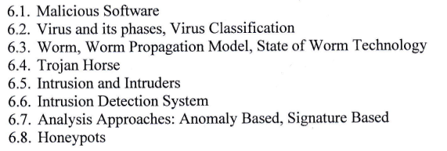
Chapter 6 : Malicious Software and Intrusion

Slide 2

The history of malware starts in the early 1970's with a worm called “Creeper”. A worm is a program that spreads to other computers by copying itself, often using a network, and this is exactly what Creeper did.

Slide 3
Famous Computer Viruses
ILOVEYOU
CryptoLocker
MyDoom
Storm Worm
Sasser & Netsky
Anna Kournikova Virus
Slammer
Stuxnet
CodeRed
Conficker

Slide 4
6.1 Malicious Software
Malicious software, commonly known as malware, refers to any software designed with malicious intent to disrupt, damage, or gain unauthorized access to computer systems, networks, or personal devices.
Malware can take various forms and may include viruses, worms, Trojans, ransomware, spyware, adware, and other types of harmful software.

Slide 5
Common types of Malware
Viruses : programs that replicate and spread by attaching themselves to legitimate files or programs. They can cause damage by corrupting or deleting files and can also spread to other systems.
Worms : self-replicating malware that can spread rapidly across networks, often exploiting security vulnerabilities. They can consume network bandwidth and cause system slowdowns or crashes.
Trojans : Trojans are disguised as legitimate software or files but contain hidden malicious code. They can perform various actions, such as stealing sensitive information, providing unauthorized access to systems, or facilitating other installations.
Ransomware : Ransomware encrypts a victim's files, rendering them inaccessible, and then demands a ransom payment in exchange for restoring access. It can spread through email attachments, malicious downloads, or compromised websites.

Slide 6
Common types of malware
Spyware: designed to monitor and collect information about a user’s activities without their consent. Track keystrokes, capture passwords, record browsing habits.
Adware: software that displays unwanted advertisements, often in the form of pop-ups or banners. Track user behaviour and collect personal information.
Botnets: Botnets are networks of infected computers, known as “bots” or “zombies”, controlled by a central command server. They can be used to launch spam emails, or perform other malicious activities.

Slide 7
6.2 Virus and its phases, Virus Classification
a computer virus is a type of malicious software that can replicate itself and spread from one computer to another, often without the knowledge or consent of the user.
Viruses can cause significant damage to systems, compromise data, and disrupt normal operations. The life cycle of a computer virus typically consists of several phases:

Slide 8
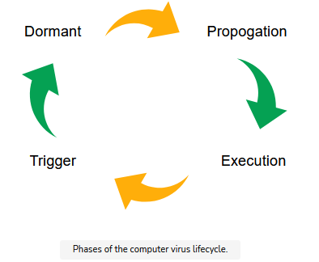
The life cycle of a computer virus
Four phases:

Slide 9
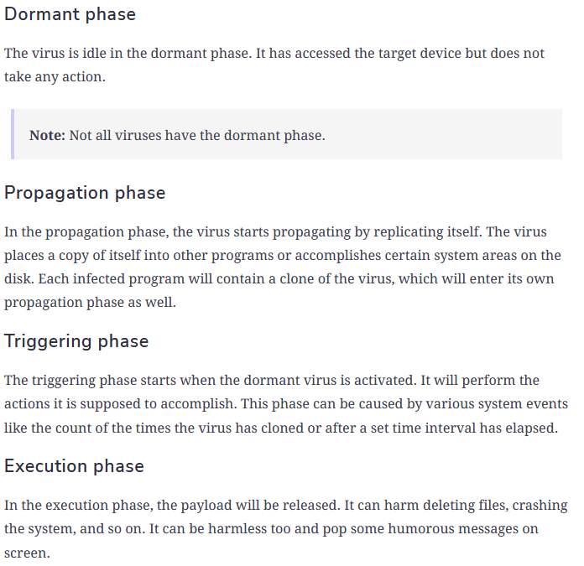

Slide 10
Virus Classification
File Infectors: These viruses infect executable files, such as .exe or .com files, by attaching themselves to the host program. When the infected file is executed, the virus code is also executed, allowing it to replicate and spread to other files.
Boot Sector Viruses: These viruses infect the boot sector of a storage device, such as the master boot record (MBR) of a hard drive or the boot sector of a floppy disk. They activate when the infected system is booted, allowing the virus to load into memory and infect other bootable devices.
Macro Viruses: Macro viruses infect documents or templates that contain macros, such as those found in Microsoft Office documents (e.g., Word, Excel, PowerPoint). When the infected document is opened, the virus executes the malicious macro code and can spread to other documents.

Slide 11
Virus Classification
4. Polymorphic Viruses: Polymorphic viruses have the ability to change their code and appearance while maintaining the same functionality. This makes them more difficult to detect using traditional signature-based antivirus methods.
5. Metamorphic Viruses: Metamorphic viruses are similar to polymorphic viruses but go a step further by completely rewriting their code, making them even more challenging to detect and analyze.
6. Stealth Viruses: Stealth viruses are designed to hide their presence and activities from detection by antivirus software. They may intercept and modify system calls, manipulate file access data, or use rootkit techniques to conceal themselves.

Slide 12
6.3 Worm, Worm Propagation, State of Worm Technology
Worm:
Worms are self-replicating malware that can spread rapidly across networks, often exploiting security vulnerabilities. They can consume network bandwidth and cause system slowdowns or crashes.
Worm Propagation:
Worm propagation refers to the spread of computer worms across networks and systems.
Worms are self-replicating malicious programs that can propagate autonomously, without requiring user intervention.
They exploit vulnerabilities in computer systems or take advantage of social engineering techniques to infect and spread to other devices.

Slide 13
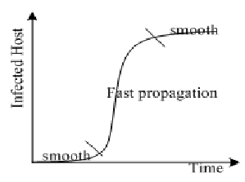
Worm propagation Model

Slide 14
Some common methods of Worm Propagation model
Network Exploitation: Worms often exploit vulnerabilities in network services or operating systems to gain unauthorized access to target systems. They can scan for vulnerable devices on a network, probe for open ports, and attempt to exploit known vulnerabilities to infect those systems.
Email Attachments: Some worms spread by sending infected email attachments to a victim's contacts. These attachments may appear harmless or disguised as legitimate files, such as documents or images.
Removable Media: Worms can spread by infecting removable media, such as USB drives or external hard drives. When an infected device is connected to a new system, the worm may automatically execute and attempt to infect that system.

Slide 15
Some common methods of Worm Propagation Model
4. Social Engineering: Worms can employ social engineering techniques to trick users into executing or opening infected files. For example, a worm may be disguised as a seemingly harmless file, such as a game or a software update.
5. Internet Worms: Internet worms exploit vulnerabilities in network protocols or services to propagate across the internet. They can scan IP addresses or domain names, looking for vulnerable systems to infect.
6. P2P Networks: Some worms take advantage of peer-to-peer (P2P) networks or file-sharing platforms to propagate. They may disguise themselves as popular files or software on these networks, enticing users to download and execute them. Once executed, the worm can infect the user's system and potentially spread to other connected peers.

Slide 16
State of Worm Technology
Advanced Propagation Techniques
Polymorphism and Metamorphism
Targeted Attacks
Botnet Integration
Automation and Self-Propagation
Exploiting Zero-Day Vulnerabilities
Collaboration with Other Malware

Slide 17
6.4 Trojan Horse
A Trojan Horse Virus is a type of malware that downloads onto a computer disguised as a legitimate program.
The delivery method typically sees an attacker use social engineering to hide malicious code within legitimate software to try and gain users' system access with their software.

Slide 18
Types of Trojans
Downloader Trojan
Backdoor Trojan
Spyware
Rootkit Trojans
DDOS Attack Trojan

Slide 19
Some common types and functionalities of Trojans:
Remote Access Trojans (RATs)
Keyloggers
Banking Trojans
Backdoors
DDoS Trojans
Fake Antivirus or Security Software

Slide 20
Security practices to protect against Trojan
Using reputable antivirus and anti-malware software and keeping it up to date.
Exercising caution when opening email attachments or downloading files from untrusted sources.
Avoiding clicking on suspicious links or visiting potentially malicious websites.
Keeping operating systems and software patched with the latest security updates.
Being vigilant for signs of unusual or unexpected behavior on your computer.
Employing firewalls and intrusion detection/prevention systems to monitor and block suspicious network traffic.
Regularly backing up important data to minimize the impact of a Trojan infection.

Slide 21
6.5 Intrusion and Intruders
Intrusion
- an intrusion refers to any unauthorized or unwanted activity that compromises the confidentiality, integrity, or availability of a computer system, network, or data.
It involves an attacker gaining unauthorized access to a protected environment, often with the intent to exploit vulnerabilities, steal information, disrupt operations, or carry out malicious activities.

Slide 22
Key aspects related to Intrusion
Intrusion Detection: the process of monitoring system and network activities to identify potential intrusions or security breaches. Intrusion detection systems (IDS) are deployed to analyze network traffic, system logs, and other indicators to detect suspicious or malicious activities.
Intrusion Prevention : network security tool (which can be a hardware device or software) that continuously monitors a network for malicious activity and takes action to prevent it, including reporting, blocking, or dropping it, when it does occur.
Internal and External Intrusions
Intrusion Techniques : Exploiting vulnerabilities, Password attacks, Network scanning, etc.

Slide 23
Intruders
an intruder refers to an individual or entity that gains unauthorized access or attempts to gain unauthorized access to a computer system, network, or data.
Intruders are also commonly referred to as attackers or hackers.
Their primary objective is to exploit vulnerabilities, steal information, disrupt operations, or carry out malicious activities within the targeted environment.

Slide 24
Key aspects related to Intruders
Motivation of Intruders: Financial Gain, Espionage, Revenge
Intruder Skill levels: Script Kiddies, Skilled Hackers, Advanced Persistent Threat Groups (APT)
Intrusion Techniques: Exploiting vulnerabilities, Social Engineering, Phishing, Password attacks, Malware

Slide 25
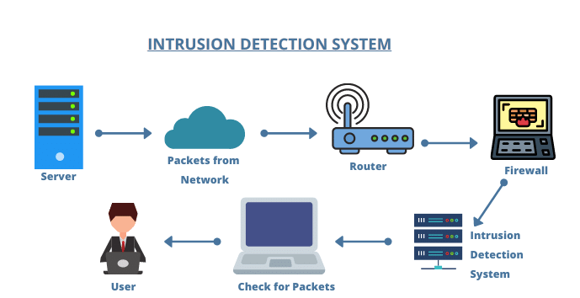
6.6 Intrusion Detection System

Slide 26
Intrusion Detection System
An intrusion detection system is a security scheme that purpose is to find malicious activity from false alarms.
Certain behaviors of intruders are: Secret Information Leakage, Active Interfering, Data Tampering
INTRUSION DETECTION CATEGORY
Network Intrusion Detection System (NIDS)
Host Intrusion Detection System (HIDS)

Slide 27
Network Intrusion Detection System (NIDS)
NIDS monitors network traffic in real-time, analyzing packets and network protocols to identify potential threats or suspicious activities.
NIDS sensors are typically deployed at strategic points within the network infrastructure, such as at the network perimeter or within internal segments, and they analyze traffic passing through those points.
NIDS can detect a wide range of network-based attacks, including port scanning, denial-of-service (DoS) attacks, and attempts to exploit known vulnerabilities.

Slide 28
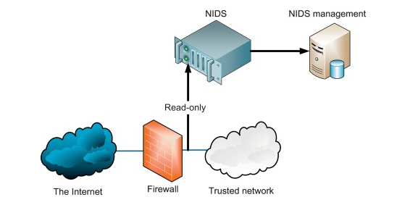
NIDS

Slide 29
Host Based Intrusion Detection System (HIDS)
HIDS operates on individual hosts or endpoints, monitoring system logs, file integrity, and other host-level indicators to detect signs of compromise or unauthorized activities.
HIDS agents are installed directly on the target hosts and collect relevant data for analysis.
HIDS is particularly useful for detecting attacks that originate from within the network or for monitoring critical systems and servers.

Slide 30
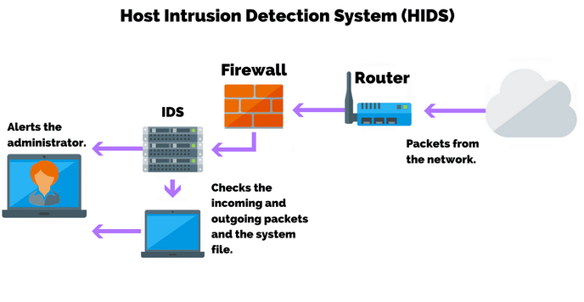

Slide 31
Intrusion Detection Methods
Intrusion detection methods are techniques and approaches used to identify and detect potential intrusions or security breaches within computer systems, networks, or applications.
These methods employ various mechanisms to monitor system activity, analyze network traffic, and identify patterns or indicators of malicious or unauthorized activities.
Some commonly used intrusion detection methods:
1) Signature-based Detection
2) Anomaly-based Detection
3) Heuristic-based Detection
4) Statistical-based Detection

Slide 32
6.7 Analysis Approaches : Anomaly based, Signature Based
Signature Based Intrusion Detection Method
This method involves comparing observed events or patterns against a database of known attack signatures.
Attack signatures are predefined patterns or characteristics associated with specific attacks or malicious activities. When a match is found, an alert is generated.
Signature-based detection is effective in identifying known threats but may struggle with detecting unknown or novel attacks.

Slide 33
Overview of analysis process: Signature based
Signature Database: The first step is to maintain a comprehensive signature database that contains predefined patterns or characteristics associated with specific attacks or malicious activities. This database is regularly updated to include new signatures as new threats emerge.
Event Collection: The intrusion detection system (IDS) collects relevant events or data from various sources such as network traffic, system logs, or application logs.
Event Preprocessing: Before analysis, the collected events undergo preprocessing. This may involve data cleaning, normalization
Signature Matching: In the analysis phase, each event or data point is compared against the signatures in the database. The IDS looks for exact matches or partial matches between the observed event and the known attack signatures.
Alert Generation: When a match is found between an observed event and a signature, the IDS generates an alert to notify security personnel or a security operations center (SOC).
Response and Mitigation: Upon receiving an alert, security personnel can initiate response and mitigation actions. These actions may include blocking network traffic from the source IP address, quarantining or isolating affected systems
Signature Updates: Signature-based intrusion detection methods require regular updates to the signature database to incorporate new attack patterns or variants.

Slide 34
Overview of Analysis: Anomaly Based
Anomaly Based Intrusion Detection
Anomaly-based intrusion detection methods are particularly useful for detecting unknown or novel attacks, as they focus on identifying deviations from expected behavior rather than relying on known attack signatures.
they may also generate false positives due to legitimate variations in behavior or incomplete knowledge of normal behavior. To improve accuracy, anomaly-based methods are often combined with other intrusion detection approaches, such as signature-based detection or behavior-based analysis.

Slide 35
Overview of analysis process: Anomaly based
Baseline Generation: This involves collecting and analyzing historical data or real-time observations of system or network activity during normal operation. The baseline captures patterns, statistics, and metrics etc. of system or network.
Event Collection: collects relevant events or data from various sources, such as network traffic, system logs, or application logs.
Feature Extraction: extract relevant features or attributes that capture the characteristics of the observed behavior.
Profile Creation: Using the extracted features, a profile or model representing normal behavior is created. This can be done using various statistical or machine learning techniques, such as clustering, regression, or time-series analysis.
Anomaly Detection: During the analysis phase, the IDS compares the observed behavior against the established profile or model of normal behavior.
Alert Generation
Response and Mitigation
8) Continuous Learning and Adaptation

Slide 36
6.8 Honey Pots
Honeypot refers to a deliberately vulnerable system or network component that is created to attract and deceive potential attackers.
The purpose of a honeypot is to distract and divert attackers away from critical systems, gather information about their tactics and techniques, and analyze their behavior.
By studying the activities of attackers within a honeypot, security professionals can gain valuable insights into emerging threats, enhance their defenses, and develop countermeasures.

Slide 37
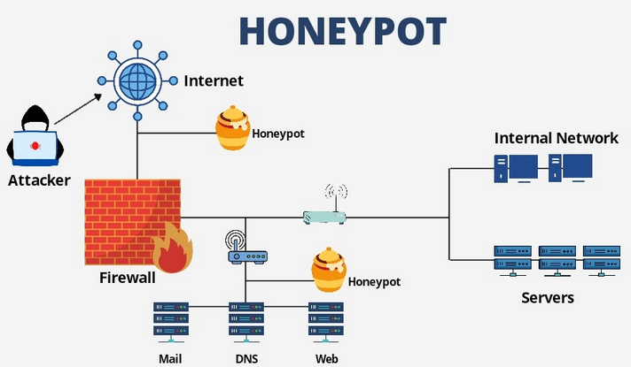

Slide 38
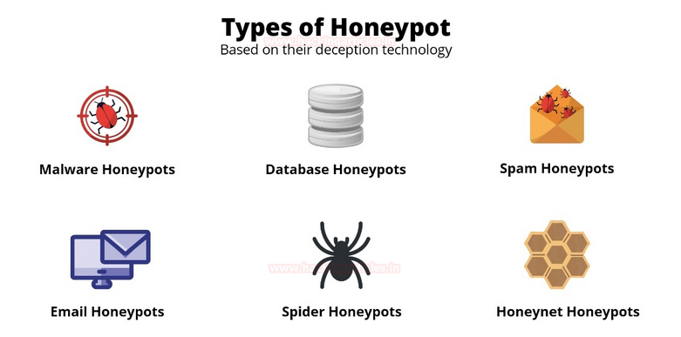

Slide 39
Types of Honey Pots
Production Honeypots: These are real systems or components that are intentionally made vulnerable and added to the production environment. They help in detecting and diverting attacks targeting the organization's actual infrastructure.
Research Honeypots: These honeypots are specifically designed for research purposes. They are often set up by security researchers or organizations to gather data on new attack techniques, collect malware samples, or analyze attacker behavior.

Slide 40
High-Interaction Honeypots: these honeypots simulate complete systems and provide extensive interaction with attackers. They offer a wide range of services and mimic the behavior of real systems, increasing the chances of attracting and capturing sophisticated attackers.
Low-Interaction Honeypots: These honeypots emulate only a limited set of services or protocols. They are easier to deploy and maintain but offer less interaction with attackers. Low-interaction honeypots are commonly used for early detection and basic analysis of common attacks.

Slide 41
Why Honeypots?
Honeypots are used in system security to detect, deflect, and study hacking attempts by mimicking vulnerable computer systems.
Detection and Early Warning
Analysis of Attacks
Deception and Diversion
Improving Defenses
Research and Education
Forensic Evidence

Slide 42
Assignment
Define honeypots and it’s types to be employed.
Explain about virus and it’s classification.
What is Intrusion detection system? Explain about it’s detection methods.

